Slide 1






MKCL’s
KLiC Internship
New Business Offering

Slide 2
Type of Internships

Slide 3
Generic Type of Internships
Internship under NEP
Internship under WBL
Undergraduate college students
Postgraduate college students

Slide 4
Why internship at ALC?

Slide 5
Why internship at ALC?
  Insufficient Workforce for Daily Operations
  Challenges in Marketing & Outreach
  Administrative Burden Affecting Efficiency
  Limited Innovation & Digital Transformation
  Lack of Cost-Effective Staffing Solutions

Slide 6
Internship to whom?

Slide 7
KLiC Internship to whom?
Senior College Students (UG & PG) – As Per NEP Guidelines
  Undergraduate students (BBA, BCA, B.Sc., B.Com, BA, BE, B.Tech, etc.)
  Postgraduate students (MBA, MCA, M.Sc., M.Com, etc.)
  Students pursuing Multidisciplinary Degrees under NEP who require practical exposure.

Slide 8
KLiC Internship to whom?
Students in Work-Based Learning or Vocational Programs
  Those enrolled in Skill Development Courses under NSQF (National Skills Qualification Framework).
  Candidates undergoing training in Digital Skills, IT, Business Management, etc.
  Polytechnic students requiring hands-on industry exposure.

Slide 9
About MKCL’s KLiC Internship

Slide 10
Internship at ALC
under KLiC Brand

Slide 11
Upto 5 Interns at each ALC
(Per Internship Cycle)

Slide 12
Internship Duration
up to 2-3 Months

Slide 13
60 Hours of Internship
for 2 Credits

Slide 14
MFO: Rs.500/- from Intern

Slide 15
Benefits to Interns
Experiential Learning
Soft Skills Development Course
Basic English Communication Course
Internship Completion / Experience Letter
Credit Award Letter

Slide 16
Benefits to ALC

Slide 17
Benefits to ALC
Cost-Effective Manpower
Increased Productivity
Pipeline for Future Employees
Enhanced Brand Reputation
New Ideas & Innovation
Better Customer Engagement
Digital and Technological Support
Support for Special Projects

Slide 18
Cost-Effective Manpower
Interns provide skilled manpower at minimal or no cost, reducing the need for additional hires.
Saves recruitment and training costs, as interns come with structured learning and guidance.

Slide 19
Increased Productivity
Interns handle routine tasks, allowing senior employees to focus on more strategic work.
They can assist in daily operations, customer interactions, administrative tasks, and marketing efforts.

Slide 20
Pipeline for Future Employees
Provides an opportunity to assess interns’ performance and hire the best talent for full-time roles.
Reduces hiring risks, as the intern is already trained in the organization's processes.

Slide 21
Enhanced Brand Reputation
Increases the ALC’s credibility as an educational hub that supports skill-building.
Strengthens relationships with educational institutions and government bodies.

Slide 22
New Ideas & Innovation
Interns bring fresh perspectives and knowledge of the latest trends and technologies.
Can contribute to social media marketing, business development, and customer engagement.

Slide 23
Better Customer Engagement
More staff availability means faster service, better customer support, and improved client satisfaction.
Interns can help with event organization, workshops, and awareness programs at the center.

Slide 24
Digital and Technological Support
Interns can assist with website management, data entry, and automation of processes.
Helps in leveraging social media, graphic design, and digital marketing strategies.

Slide 25
Support for Special Projects
Interns can contribute to research, surveys, and data analysis for business improvements.
They can help in content creation for promotional materials.

Slide 26
Implementation at ALC

Slide 27
MKCL KLiC Internship
Life Cycle

Slide 28
MKCL KLiC Internship
Life Cycle Process
Expression of Interest (EOI) by ALCs
Approval of ALCs
Letter to Collage and MoU Signing
Course Allocation
Student Enrollment for KLiC Internship
Intern Learning on Smart phone & Working
Monitoring & Evaluation by ALC
KLiC Internship Credit Certification from MKCL
Selection of Students for Internship

Slide 29

Monitoring & Tracking
Sequential Learning
Weekly Work Report

Slide 30
Course Structure
Basic English
Soft Skills
Job Readiness Skills
Weekly Report

Slide 31

Basic English

Slide 32

Soft Skills

Slide 33
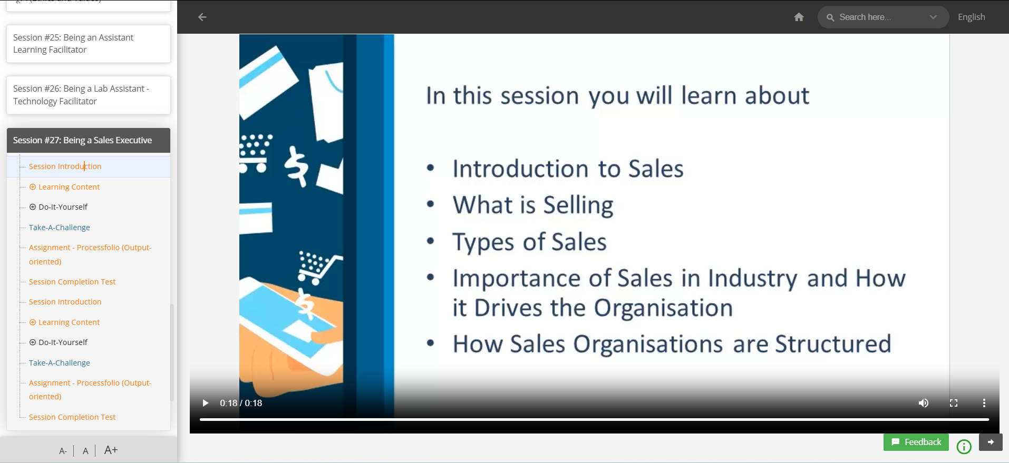
Job Readiness Skills

Slide 34
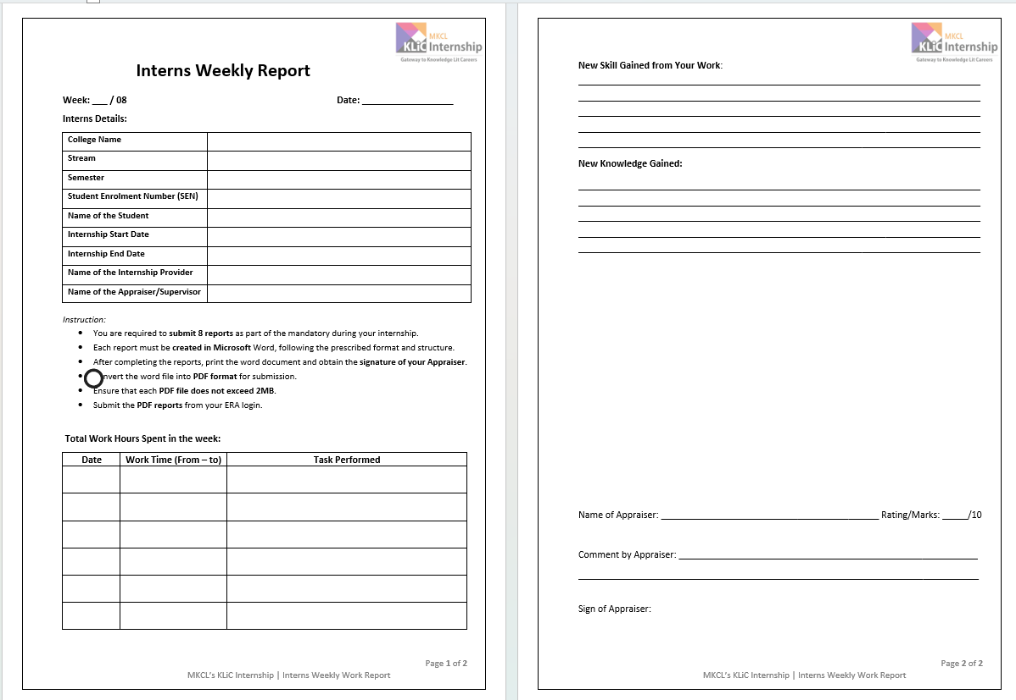
Notes:
Auto Evaluation By AI and Marks entries, Constructive Feedback

Slide 35
Sample Job Roles
for Interns

Slide 36
Sales Executive

Slide 37
Social Media Marketing

Slide 38
Learning Facilitator

Slide 39
Office Assistant

Slide 40
Counsellor

Slide 41
Digital Content Creator
And So on…

Slide 42
Enrollment of Intern

Slide 43
Interns Enrolment Process
College shall refer students to ALC
Student shall Visit respective ALC
Information about KLiC Internship
Student Registration for KLiC Internship
Intern Will pay KLiC Internship Course Fee
ALC shall issue receipt to the student
ALC shall update student’s internship record in Solar
ALC shall issue an Internship Award Letter
Student can submit this Internship Award Letter to the College.
Learner Code allotment to Intern & data transfer to the Learning Framework"
ALC shall communicate the details to the Learner

Slide 44
Roles & Responsibilities- ALC
Offer
Offer internships to max 5 interns for at least 2 month
Guide
Guide interns on Job Role & Code of Conduct
Facilitate
Facilitate learning, track progress, and evaluate performance of interns
Maintain
Maintain performance records & issue Experience/ Completion Letters

Slide 45
Roles & Responsibilities- Interns
Complete daily learning & assigned tasks
Submit weekly reports & final internship report
Adhere to ALC’s tracking & evaluation process

Slide 46
MKCL’s KLiC Internship Sample Documents

Slide 47
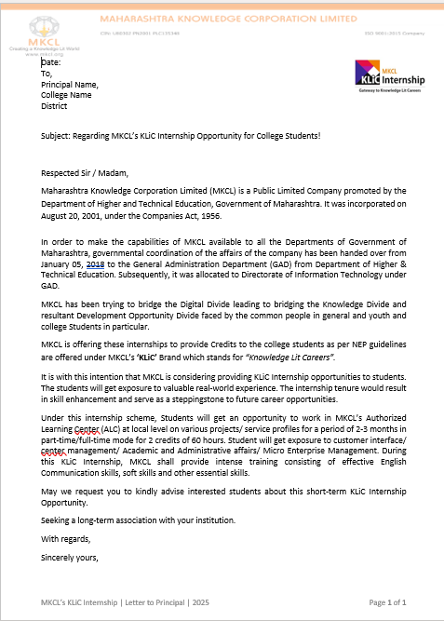
Letter to Principal

Slide 48
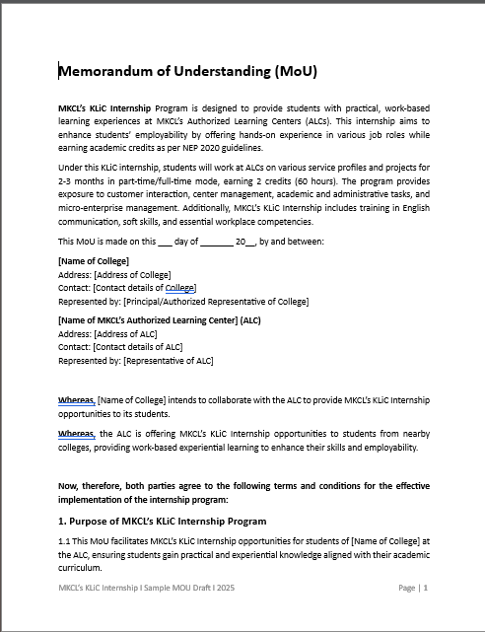
MOU with College

Slide 49
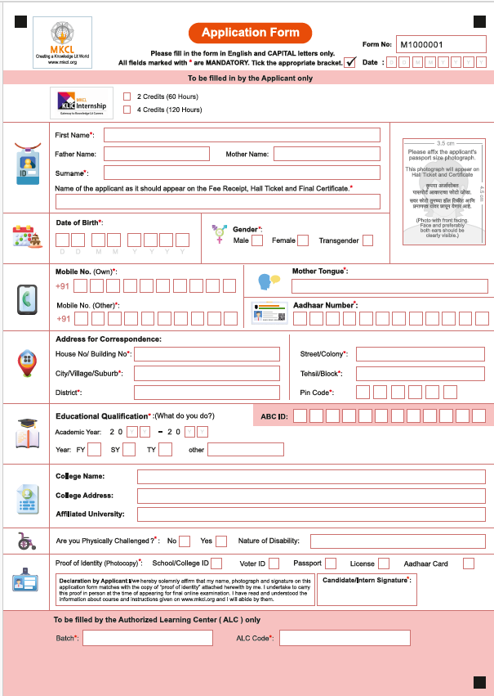
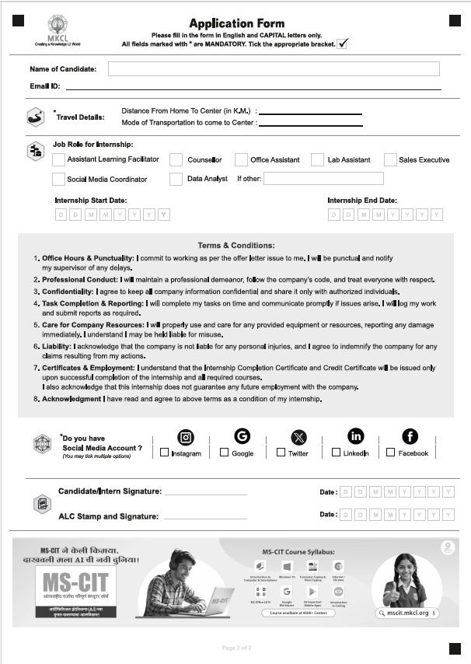
Application Form

Slide 50
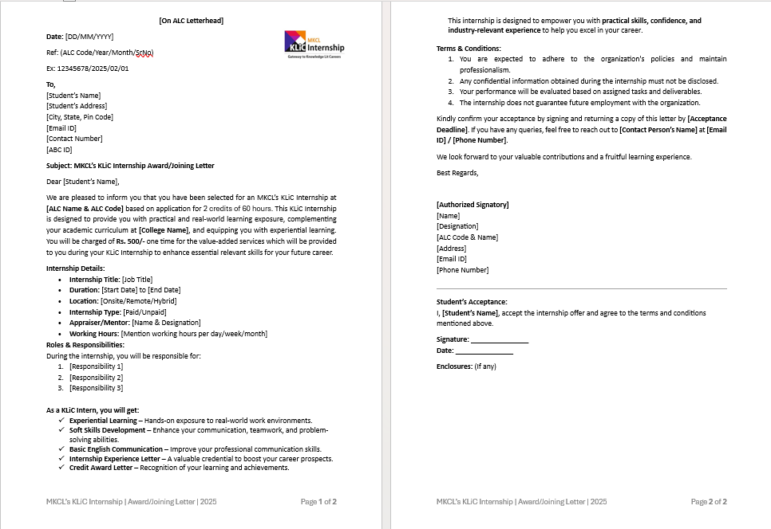
Award / Joining Letter

Slide 51
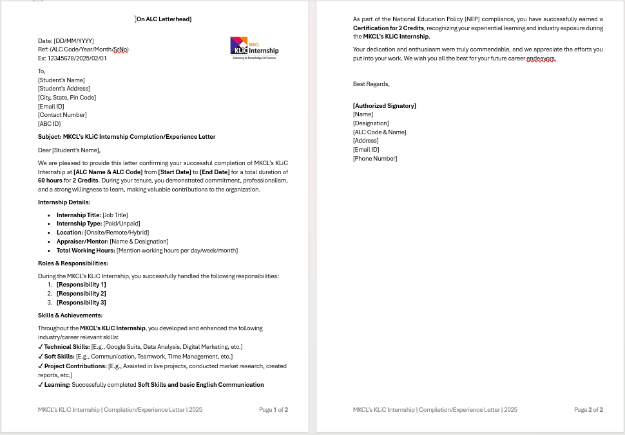
Completion / Experience Letter

Slide 52
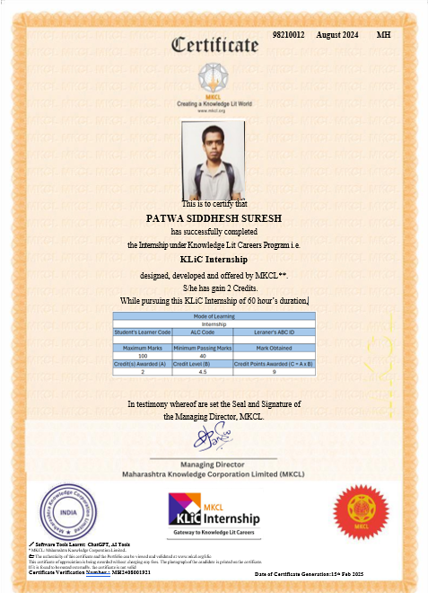
Credit Certificate by MKCL

Slide 53
Call for Action
Submit EOI in Solar
Identify the nearby Colleges & Complete MoU
Overall readiness as Internship Provider
Wide Publicity through Social Media
Notes:
Code of conduct

Slide 54
Thank You!

